Slide 1
“GUIDELINES FOR CREATING
A “PROTECT YOUR TERRITORY” (PYT)
WEB PAGE (SITE) –
`
“LOCAL KNOWLEDGE,
CREATIVE INFORMATION AND ENGINEERING TECHNOLOGIES
OF THE STUDENTS
AND MASS MEDIA AGAINST DISASTERS”.

Slide 2
COORDINATOR OF THE PROJECT : European Interregional Scientific and Educational Centre on Major Risk Management, Yerevan, Armenia

Slide 3
1. RESPONSIBILITY AND ACTIVE PARTICIPATION OF EVERYONE IN PROTECTING HIS/HER TERRITORY
In the end of the 20th century and beginning of the 21th century around two billion people that i.e. a third part of the total mankind were found to be affected by natural disasters. The number of disaster victims made more than 20 million during that period.
The lessons of the natural disasters, including of the Spitack earthquake of December 7 1988 in Armenia, as well as the first lessons that have already been learned from the consequences of the recent earthquakes (in February 2023) that hit Turkey and Syria, and from the 2023 inundations cаused flooding of considerable territories in many countries of the world,

Slide 4
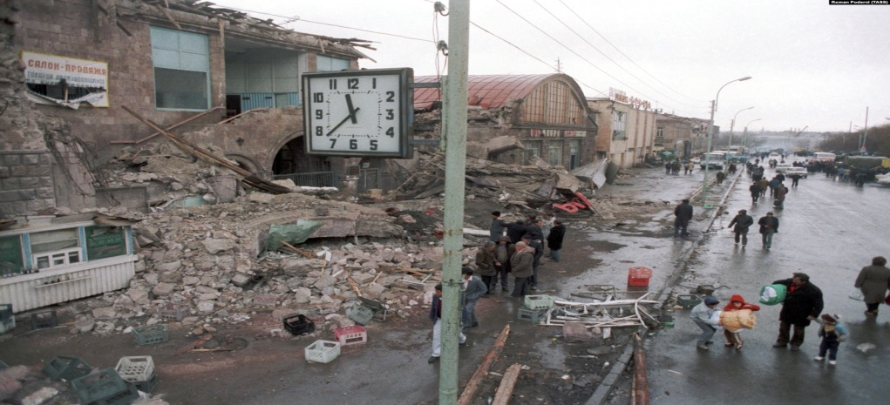
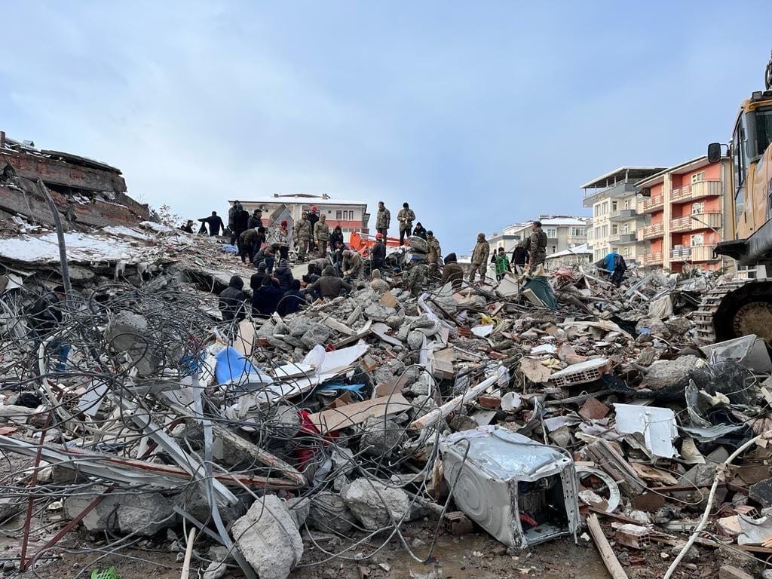
RESPONSIBILITY AND ACTIVE PARTICIPATION OF EVERYONE IN PROTECTING HIS/HER TERRITORY (continuation)
demonstrated, that the scale of the tragic consequences has been partially predetermined by the imperfection of the National disaster management systems, insufficient engaging communities into disaster risk reduction and insufficient level of knowledge and skills of adequate behavior in people at threat of natural disasters and at natural disasters themselves.

Slide 5
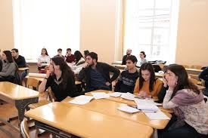
THE KNOWLEDGE OF A FEW THAT BECOMES THE KNOWLEDGE OF EVERYONE
Many natural and other disasters that have affected countries, their individual regions and territories could have been avoided if their territories had been regularly maintained (the risks of probable, often recurring disasters had been reduced).

Slide 6
AND QUITE ALWAYS THE MEDIA NEWS FROM THE PLACES WHERE DISASTROUS EVENTS HAVE OCCURRED REPORT THAT
Many people living in these places were aware of the risks they were exposed to, because those risks were obvious and recurring very often.
People's awareness of risk situations, however, rarely leads to actions (intervention) useful for their elimination.
On the one hand, because preventive actions to maintain territories (reduce the risks of probable disasters) are scarcely covered by mass media. More over before the occurrence of a disaster, media are not at all interested in population`s “Local Knowledge”, which becomes “news” only after disaster.

Slide 7
AS A CONSEQUENCE, IF THERE IS NO MEDIA COVERAGE
As a consequence, if there is no media coverage, the population`s “Local Knowledge” about existing risks is out of the spotlight of the politicians, responsible for making decisions on the implementation of preventive actions, and decision-makers do not give priority to the maintenance of the territory.
On the other hand, because there is no system of automatic transmission of information from the one, who is aware of the hazards (often directly from the place of the identified hazard) to the one, who is responsible for their elimination.
And thirdly, because school students and young people, in general, are almost not involved (or weakly involved) in the processes of identifying local hazards and in the activities of the systems for automatic information transmission about them (if such systems are created).

Slide 8
THE CREATIVE INFORMATION AND ENGINEERING TECHNOLOGIES OF THE SCHOOL STUDENTS (YOUNG PEOPLE IN GENERAL) AGAINST DISASTERS
Meanwhile, in modern conditions, students (young people), who possess skills and successfully operate in the field of information and engineering technologies, provided that they acquired the necessary knowledge in the field of disaster risk reduction and are appropriately motivated can be creatively involved in the processes of development and ensuring effective functioning of the modern territorial (provincial, municipal) systems of automatic transmission of information as for reporting hazards and preventing disasters,
as well as for increasing the responsibility and active participation of everyone in the protection of his/her territory and for ensuring its sustainable development, and also for acquisition and consolidation of leadership qualities, necessary for performing successful activities in the various areas of development of their community (province, country as a whole).

Slide 9
ն
CUEBC THE EUROPEAN UNIVERSITY CENTRE FOR THE CULTURAL HERITAGE (RAVELLO, ITALY)
By using the web site “UNESCO Amalfi Coast” the European University Centre for the Cultural Heritage (Ravello, Italy) has then created the page “Protect Your Territory” (PYT), whose purpose is that of collecting the reports of citizens and visitors about the situations of risk, which could be found on their territory (quarter, area, province ), of transmitting them to the competent bodies for taking consequent actions, and local media, for the follow up monitoring.
The page explains its purpose and contains a “REPORT FORM” (RF), shows how to report a situation of risk, as well as follow up report related actions.

Slide 10
LOCAL KNOWLEDGE, CREATIVE INFORMATION AND ENGINEERING TECHNOLOGIES OF THE STUDENTS AND MASS MEDIA AGAINST DISASTERS
ECRM, Yerevan, Armenia started working on the LoKSAND project as partner-centre, based on the documents of information and methodological nature, kindly provided by the CUEPS, Ravello, Italy the Coordinator Centre of the Project, by given the specifics of Armenia. Due to certain objective reasons work on the Project by ECRM in 2021 was interrupted and decided to be suspended till 2022-23.
Starting 2023 we began to develop independently a new, modified pilot Project, by given the specifics of Armenia, namely:
“LOCAL KNOWLEDGE, CREATIVE INFORMATION AND ENGINEERING TECHNOLOGIES OF THE STUDENTS AND MASS MEDIA AGAINST DISASTERS”. (Involving School Students into Creative Activities in the Field of Development and Ensuring Effective Functioning of Territorial Online Tools (“Protect Your Territory” PYT Web Page) through Information and Engineering Technologies).
“LOCAL KNOWLEDGE, CREATIVE INFORMATION AND ENGINEERING TECHNOLOGIES OF THE STUDENTS AND MASS MEDIA AGAINST DISASTERS”. (Involving School Students into Creative Activities in the Field of Development and Ensuring Effective Functioning of Territorial Online Tools (“Protect Your Territory” PYT Web Page) through Information and Engineering Technologies).

Slide 11
INTERACTION BASED ON THE TRANSFER OF PROBLEMS, EXCHANGE OF EXPERIENCES AND RESULTS
Naturally the new, modified pilot Project proposed by us is being elaborated, bringing a new quality to the development of ideas underlying the previous Project, and is focused primarily on enhancing creativity and motivation for involving students (young people) in the processes of increasing the effectiveness of functioning of territorial online tools (PYT Pages) for reporting hazards and preventing disasters, for increasing responsibility and active participation of everyone in the protection of his/her territory.
The elaboration of new Project is being carried out by given valuable experience of CUEPS, taking into consideration the European values. However, the facilitation process not a one-way communication process, at the same time it is an interaction process based on the transfer of problems, exchange of experiences and results.

Slide 12
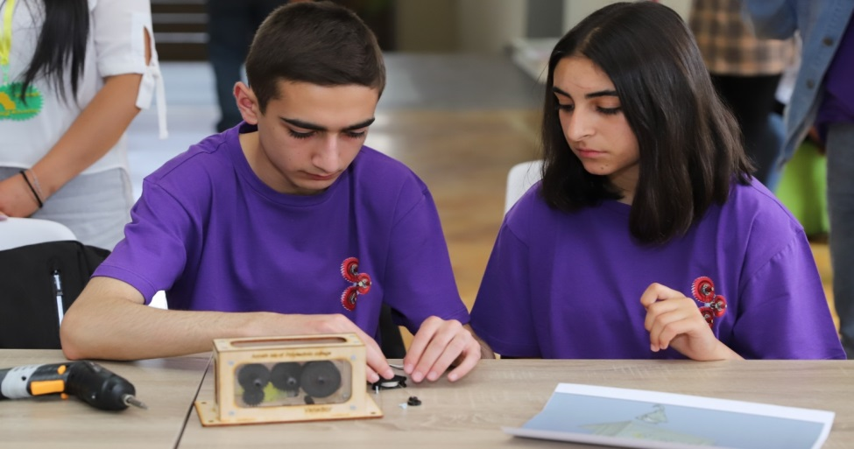
“TUMO” Centres for Creative Technologies and the “ARMATH” engineering laboratories UNIQUE EDUCATIONAL STRUCTURES FOR CREATIVE INVOLVEMENT OF STUDENTS (YOUNG PEOPLE) IN THE PROTECTION OF HIS/HER TERRITORY
The effectiveness of the Project will be largely predetermined by the degree of motivation, creative involvement and preparedness of students (young peoples), which is a task that requires a regular solution. Fortunately in Armenia at school level have been set up unique educational structures successfully operating in the field of information and engineering technologies “TUMO” Centres for
Creative Technologies
and the “ARMATH”
Engineering Laboratories.

Slide 13
HIGHLY INNOVATIVE EDUCATIONAL METHODS APPLIED BY “TUMO” AND “ARMATH”, AND FUNCTIONING OF THE PYT Web Pages
Based on a brief description of unique educational structures in the field of information and engineering technologies: “TUMO” Centres for Creative Technologies and “ARMATH” engineering laboratories, set up and being successfully operated in all provinces of Armenia at the level of public and secondary schools, due to highly innovative educational methods applied by “TUMO” and “ARMATH”, taking into account the presence of training centres, such as inter - municipal educational complex in Debed village of the Lori province, where students from dozens of villages among other things are elaborating a Pilot project for the creation of models and Web Sites aimed at the development of rural municipalities,
students mastering the developed varies of soft skills, have a high degree of preparedness and motivation sufficient for successful involvement in the processes of reporting hazards through mobile phones to territorial (provincial) PYT Web Page for preventing disasters, as provided by the LoKSAND project methodology,
,

Slide 14
FLYING VEHICLES AND GROUND – BASED ROBOTS ARE THE EFFECTIVE MECHANISMS FOR DETECTING AND ELIMINATION OF HAZARDS THREATENING THEIR TERRITORY
however the uniqueness of “TUMO” and “ARMATH” lies in the fact that students have the necessary skills and teamwork experience in the field of Robotics, including in the field of designing unmanned aerial vehicles and various ground - based robots with a wide range of activities.
And thus, subject to a clear gradation and description of probable hazards characterizing of a particular province, opens up wide opportunities for involving students also in the design and use of both: flying vehicles and ground - based robots to detect and monitor hazards and online transfer of more visual and complete information and to report about risks, including from hard-to reach for human territories and hazardous areas, on the modified provincial “PYT Web Page”.

Slide 15
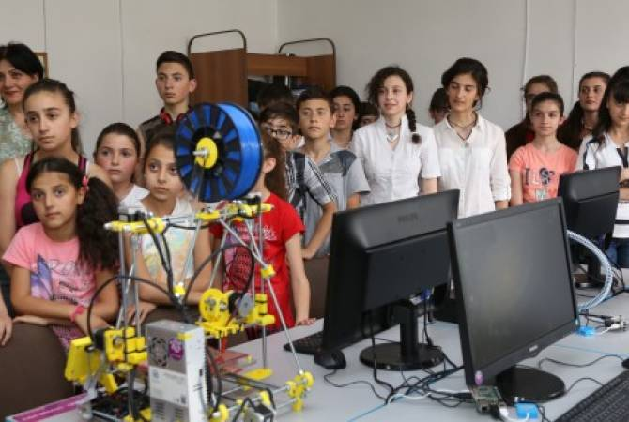
RESULTS AND VALUABLE EXPERIENCE OF THE “PYT” PILOT PROJECT ON THE EXAMPLE OF SELECTED PROVINCE CAN BE SUCCESSFULLY IMPLEMENTED IN ALL OTHER PROVINCES OF THE REPUBLIC.
The above will serve as the best motivation for involving students into creative activities in the field of disaster risk reduction and protection own territory through information and engineering technologies.
And since “TUMO” Centres for Creative Technologies and the “ARMATH” engineering laboratories have been set up and successfully operate in all provinces of Armenia, results and valuable experience of suggested new modified pilot Project on the example of selected province can be successfully implemented in all other provinces of the republic.

Slide 16
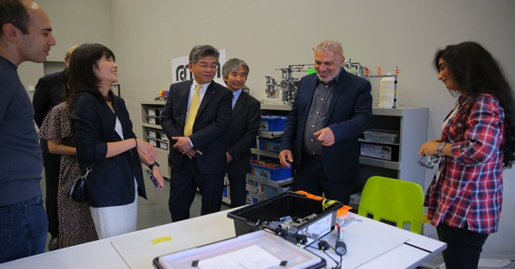
THANKS TO THE CLOSE COOPERATION OF “TUMO” AND “ARMATH” STRUCTURES OF ARMENIA WITH THE STRUCTURES OF THE SAME NAME IN PARTNER-COUNTRIES, THE EXPERIENCE OF THE “PYT” PILOT PROJECT CAN BE TRANSFERRED TO THE PARTNER-COUNTRIES, AS WELL AS TO THE OTHER CONCERNED COUNTRIES
In turn, thanks to the close cooperation of “TUMO” and “ARMATH” structures of Armenia with the structures of the same name in partner-countries, the experience of CUEPS, Ravello, Italy in the developing and operating LoKSAND project, as well the experience of ECRM, Yerevan, Armenia in suggested MODIFIED Project, taking into account the creative possibilities of the students of the “TUMO” and the “ARMATH” in the field of information and engineering technologies, can be transferred to the partner-countries, as well as to the other concerned countries.
TUMO IN JAPAN
With the help of Armenian “TUMO” Centre for Creative Technologies international “TUMO” Centres were opened in partner - countries: in Paris, Luxemburg, Berlin, Beirut, Tirana, Los Angeles, Tokyo, Moscow, Kiev.

Slide 17
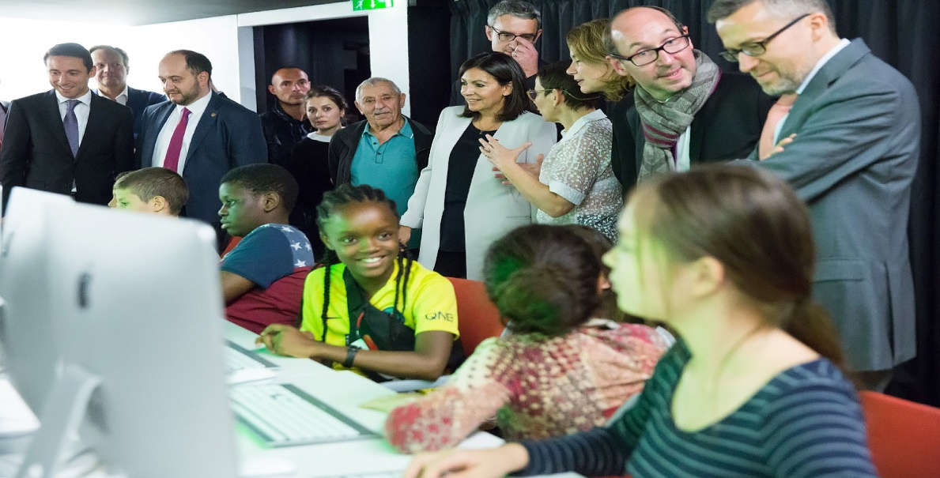
THE “TUMO” CENTRE IN PARIS was opened on October 15, 2019 ON THE INITIATIVE OF MAYOR OF PARIS ANNE HIDALGO
The “TUMO” Centre in Paris was opened on October 15, 2019 on the initiative of Mayor of Paris Anne Hidalgo, who visited Yerevan in January 2018. In Parisian "TUMO" have been trained more than 4000 students. Mayor of Paris noted: “With the help of “TUMO” we provide the youth of Paris with all the tools necessary for shaping the future world”.

Slide 18
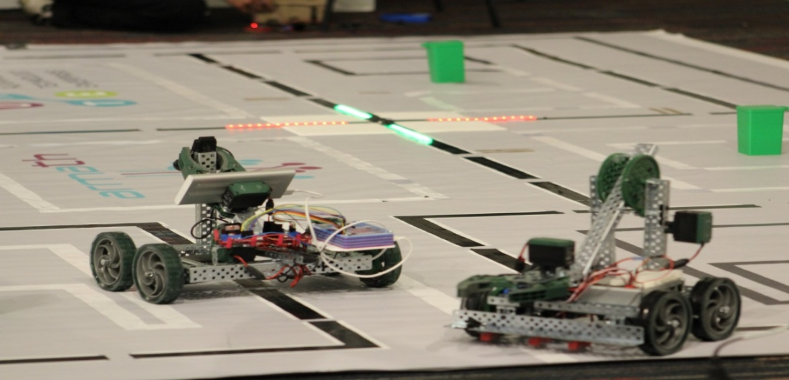
ARMENIAN TECHNOLOGY EDUCATION MODEL PRESENTED BY “ARMATH” HAVE ALREADY BEEN IMPLEMENTED IN THE SCHOOLS OF DIFFERENT COUNTRIES
Armenian technology education model presented by “ARMATH” have already been implemented in the schools of such countries, as: India, Ethiopia, Afghanistan. Moreover, the number of countries such as Greece, Bulgaria, Lithuania, Estonia, Bangladesh, Malaysia, Brazil, Iraq and a number of other countries as well showed
great interest towards
the “ARMATH” project.

Slide 19
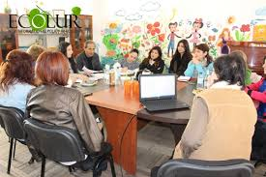
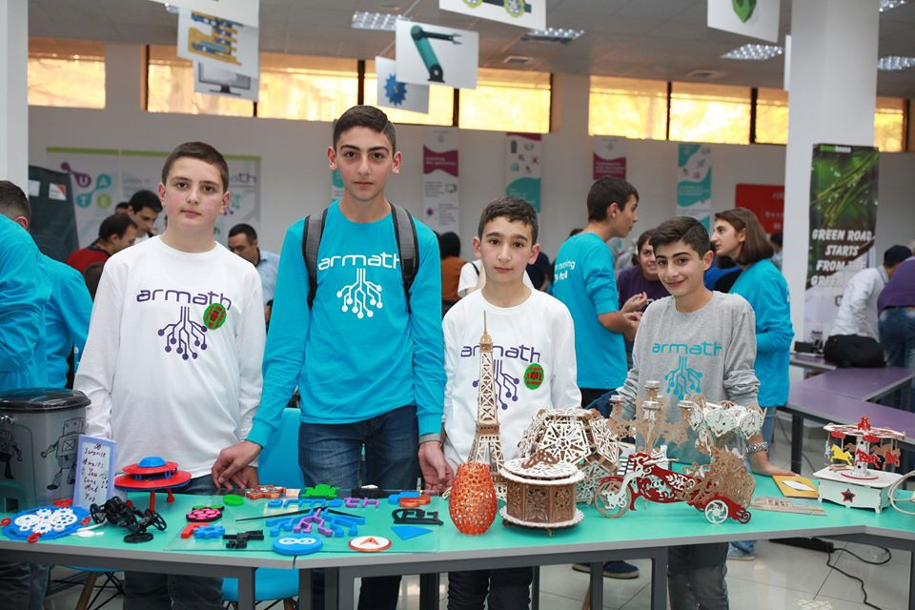
2. USEFUL GUIDELINES FOR THE CREATION OF THE “PROTECT YOUR TERRITORY ” (PYT) Web - pages
To make PYT Web pages an effective tool for disaster prevention, it is important to involve the local community (primary the young people)
not only in their use, but also in their creation.

Slide 20
USEFUL GUIDELINES FOR THE CREATION OF THE “PROTECT YOUR TERRITORY” (PYT) Web - pages
a) PRELIMINARY STAGE
A research on the local media websites can help selecting the most recurring news about the instability affecting the territory over the last years.
Another very useful instrument is a map of the local environmental protection associations
The data which can be collected at this stage help to carry out a more specific research, according to the scientific literature found, as regards the disasters that have affected that territory.
b) ACQUISITION OF DATA ON THE LOCAL DISASTERS AND ABOUT THE KNOWLEDGE THAT THE LOCAL POPULATION HAD ABOUT THEM
The preliminary analysis of the news, the map of the local
associations and the scientific literature found allow us
to determine:

Slide 21
• the key words by which it is possible to carry out a systematic research on the disasters occurred; • their presence in the media; • the possible reports made by citizens, associations or institutions; • the result of these reports;
THE PRELIMINARY ANALYSIS OF THE NEWS, THE MAP OF THE LOCAL ASSOCIATIONS
AND THE SCIENTIFIC LITERATURE FOUND ALLOW US TO DETERMINE:
նքը:

Slide 22
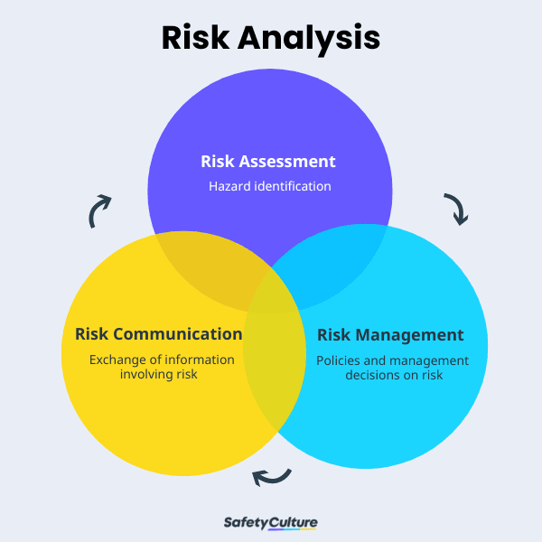
c) ANALYSES OF THE ACQUISITION SYSTEMS AND TRANSFER OF REPORTS
In order to avoid any duplication of procedures, it is important to analyze which procedures are already existing for the collection and management of information of risk by citizens, by:
making a list of the institutions
appointed to receive reports of
immediate or non immediate risk
analyzing how reports
are managed
analyzing the interventions
caused by reports

Slide 23
d) SYSTEMATIZATION OF THE DATA COLLECTED DURING THE STAGES a), b) and c)
The systematic analysis of the collected data is important and necessary, in order to suggest the necessary adjustments to the system of collection and management of reports. In order to develop operational suggestions from this kind of analysis, it is useful to carry it out, by:
• a well pondered synthesis of reports and interventions
• a statistical analysis of reports
and interventions, made
according to site, typology,
source and result

Slide 24
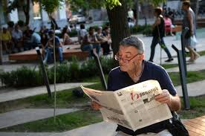
e) CONTACTS WITH LOCAL MEDIA
At this point of the procedure, it is important to promote a meeting with all the media operating on the territory, in order to illustrate the data and the analyses carried out and to check whether it is possible to find a collaboration for the creation of the PYT pages.

Slide 25
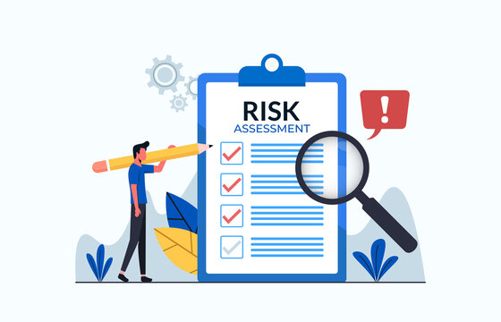
f) PRODUCTION OF THE DRAFT FORM
According to the data collected and the analyses carried out and the opinions emerged in the meetings with the Media,
the draft version
of the report form can be produced, as well as that of the page structure and its management.

Slide 26
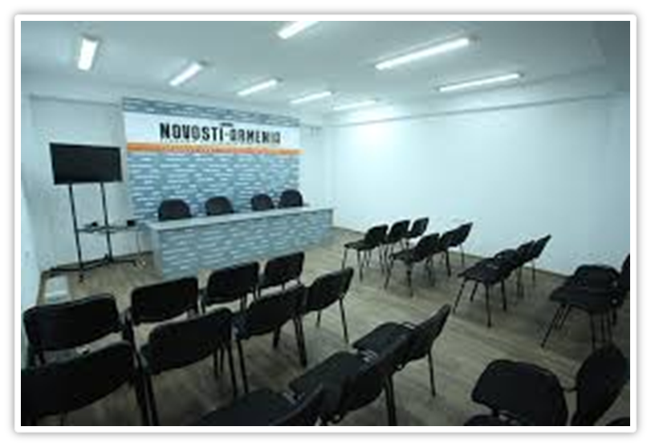
g) PRESENTATION OF THE PYT PAGE
The production procedure ends with a public event of presentation of the PYT Page

Slide 27
h) PRESENTATION FOLLOW UP
In order to officially start the PYT Page, it is necessary to publicize
its address and its goals by
all the possible means (media, social networks).

Slide 28
3. THE REPORT FORM.
In order to make the goals of the PYT Page easy to understand, and then to make it easy to use it, it is better that the first field of the Report Form suggests a list of situations of risk to report, which have been identified as those really recurring on that territory, and which are described by non-technical words and provided with synthetic decryptions of the possible disaster.
……………………………………………………
***) It is important to underline that the PYT page does not substitute the institutional services to be used in case of emergency and in case you must report an imminent danger, you have to refer to the local emergency numbers.

Slide 29
3.1 WHAT TO REPORT
With reference to the most frequent situations of risk which may occur, the field in the form could be as follows:
A) Stream beds, canals or impluviums blocked by branches, debris or landslides. In case of heavy rains, water accumulates upstream the obstruction, which then collapses, thus causing a flood, which violently flows downstream at a high speed.
B) Not watertight canalization. The leakages of canals can penetrate the surrounding soil, thus causing the collapse of embankments or buildings.
C) Collapsed or cracked walls retaining terraces or embankments. A localized, even little collapse, can give place to a process of generalized landslide.
D) Loose land slopes, or slopes little planted with trees, or intensely built slopes, or slopes not provided with suitable canalization for water flow. In case of heavy rains the land, which is not retained by roots, or is altered by buildings, can slide down.
E) Not cleared out undergrowth. Bushes, especially if they are dry, are highly inflammable: they easily cause fires and immediately spread them.

Slide 30
WHAT TO REPORT
F) Rocks characterized by a precarious balance, which can be found above all along the routes which are not controlled by the institutions (pathways, steps, mule tracks). Heavy rains – or earthquakes, even if they are weak – can cause their fall, which is particularly dangerous along trekking routes.
G) Rocky ridges touched with fire. The high temperatures produced by fires cause the cracking of rocks that may collapse.
H) Precious buildings (churches, mansion houses, historical aqueducts) or elements worth reporting (wayside shrines, caves) which are in degraded situations, or threatened by one of the above mentioned dangers.
The lack of maintenance, or the occurrence of an external danger, can cause the loss of the cultural evidence, or its damage.
I) Other situations of risk
Any other situation which is considered worth reporting.
Ը) Մշակութային կամ պատմական արժեք ներկայացնող շենքեր (եկեղեցիներ, մատուռներ, առանձնատներ, պատմական ջրացույց կամուրջներ), կամ հիշատակման առարկա հանդիսացող օբյեկտներ (ճանապարհամերձ սրբավայրեր, քարանձավներ և այլն), որոնք գտնվում են անմխիթար վիճակում կամ վերը նշված վտանգներից մեկի սպառնալիքի ներքո:
Թ) Ռիսկի հետ կապված այլ իրավիճակներ, որոնց մասին արժե հաղորդել:

Slide 31
3.2 HOW TO REPORT A SITUATION OF RISK
Other instructions to give are above all those that explain how to report a situation of risk.
Since that not everyone can use a computer, and because the report must be immediately traceable, in order that it can be suitably managed, it is necessary that at least two ways of sending a report to the PYT Page are provided:

Slide 32
3.2 HOW TO REPORT A SITUATION OF RISK (continuation)
a) through the PYT Page itself,
by using the Report Form provided by it
b) by sending a photo by WhatsApp, to a special address,
and giving details about the site concerned
and, if you wish to be informed
about the report follow up,
the name and the contacts of
whom sends the report message.

Slide 33
3.3 WHO SENDS THE REPORT MESSAGE
The protection of the privacy of who sends a report message, must be always guaranteed.
The report message can be sent in an anonymous or public mode.
In the Report Form, it is important that the following three options are provided:

Slide 34
THE REPORT MESSAGE OPTIONS
a) no mention of the author of the report
b) no mention of the author of the report with the possibility for him to be informed about the follow up of the report itself;
in this case the author’s identity shall be known to the staff but not publicized, thus in observance of the privacy rules
c) mention of the author of the report

Slide 35
3.4 FOLLOW UP THE REPORT
In order to make the PYT Page efficient and productive, it is important that the author of the report, as well as the users of the page, are informed about the follow up of the report itself.
A possible processing procedure of the report made through the web page, or the WhatsApp number, is the following:

Slide 36
A PROCESSING PROCEDURE OF THE REPORT
a) as soon as the report is received, its reliability is ascertained by examining the right inclusion in the different categories, and the site of the danger;
b) the report is then given a code number, which is communicated to its author (if he has accepted to receive it) and which shall make it always traceable in the future, both by the system and by other visitors;
c) if necessary, further details of the author of the report can be requested (if he is willing to provide them);
d) the report is then transmitted to the institutions being competent for managing it and to the local media;
e) the report is indicated on a map of the site involved, with the code number representing its category; the whole of the reports included in each category can be separately viewed;
f) every three months, the management stage of the report is checked;
g) the checking report is then transmitted to the local media.
է) ստուգման հաշվետվությունը այնուհետև փոխանցվում է տեղական լրատվամիջոցներին:

Slide 37
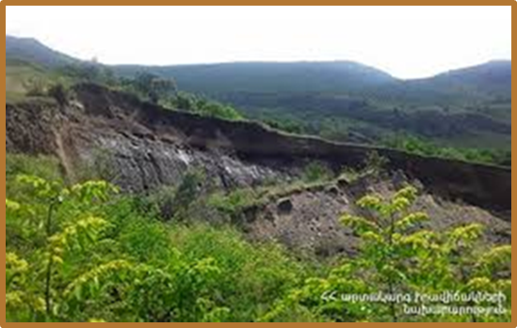
4. THE REPORT FORM USED ON THE AMALFI COST
The following Report Form, which has been drawn up during research, refers to the recurring disasters occurring along the Amalfi Coast, but the criteria on which its different fields are based, are of a general kind.
They can be used to create similar pages also in other contexts.

Slide 38
THE REPORT FORM

Slide 39
A) THE REPORTED SITUATION
1. Where is the situation of risk?
Town ………………………………… Village………………………..
Site …………………………………… Via ……………………
2. In which category can the situation of risk you report, be included?
Stream beds, canals or impluviums blocked by branches, debris, garbage or landslides.
Not watertight canals.
“Dry stone low walls (the walls retaining terraces) collapsed or being about to collapse.
Not cleared out undergrowth.
Unstable rocks, situated above all along the routes not controlled by the institutions (pathways, steps, mule tracks).
Precious buildings or elements being worth reporting, which are in degraded conditions, or which are threatened by one of the above mentioned dangers.
Other situations of risk………………………………………………………….

Slide 40
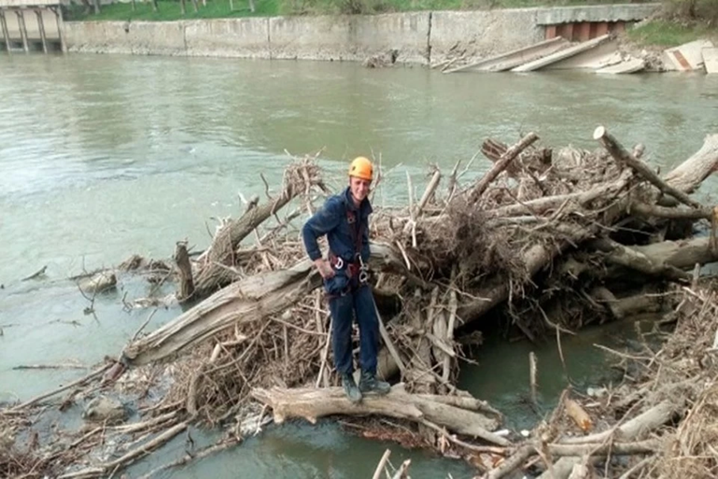
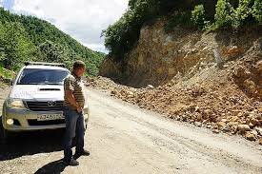
A) THE REPORTED SITUATION (continuation)
3. Similar situations of instability have already been occurred in this area (province)
No
Yes When? ……………………..
I do not know

Slide 41
A) THE REPORTED SITUATION (continuation)
4. Has the situation of risk been already reported?
No
YES
When? ………………….
To whom? ………………….

Slide 42
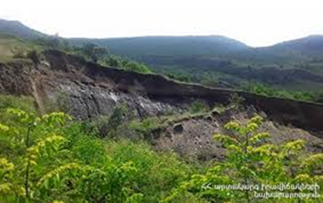
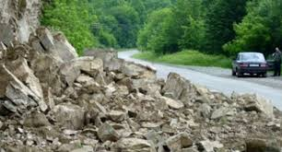
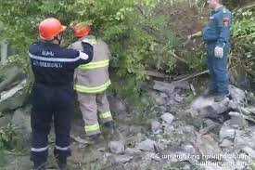
A) THE REPORTED SITUATION (continuation)
5. Has a follow up of the foregoing reports been there?
No
YES
Which? ………..

Slide 43
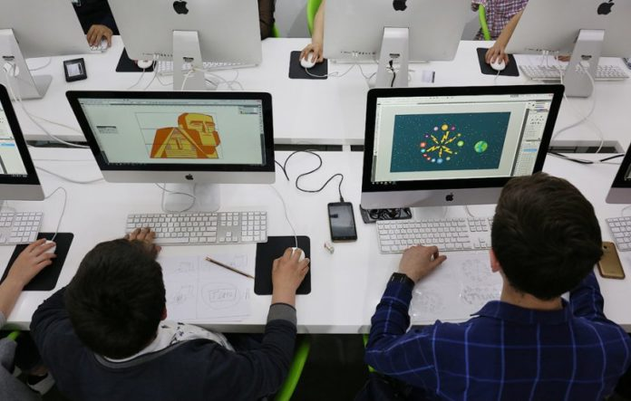
A) THE REPORTED SITUATION (continuation)
6. Would you like to add a photo?
No
YES ……………………..

Slide 44
A) THE REPORTED SITUATION (continuation)
7. Would you like to add a comment?

Slide 45
B) THE REPORTER (author of the report message)
1. The report will be examined and transmitted to whom is competent for interventions and to the local media.
Do you want to be mentioned as author of the report?
No
No, but I want to be informed about the follow up of report (see point 2)
YES. Who is the author of this report ? ……………………

Slide 46
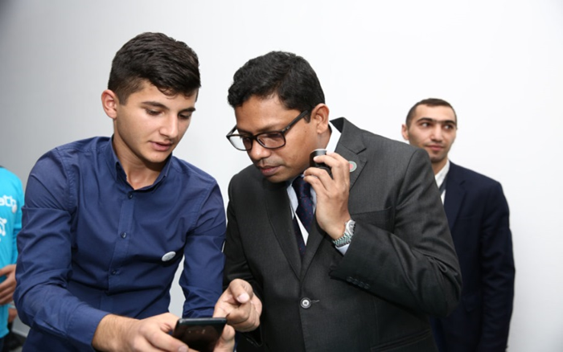
B) THE REPORTER (author of the report message) (continuation)
2. Do you want to be informed about the follow up of your report?
No
YES How? e-mail …………………………………..,
WhatsApp ………………..,
SMS (the report message by phone)…………,

Slide 47
5. BRIEF CONTENT OF "PROTECT YOUR TERRITORY“ REGIONAL WEB PAGE
5.1 The PYT Web page explains the purpose of the Web site, contains a "MESSAGE FORM", mechanisms for transmitting a message and subsequent actions regarding the message itself.
WHAT TO REPORT? HOW TO REPORT? WHO SENDS THE MESSAGE?
WHAT IS HAPPENING TO THE MESSAGE?
ADDITIONAL INFORMATION O N THE REPORTED RISK RELATED SITUATION.
TRACKING THE FOLLOW-UP REPORT RELATED ACTIONS.

Slide 48
BRIEF CONTENT OF "PROTECT YOUR TERRITORY“ REGIONAL WEB PAGE
5.2 The page also contains educational information about the territory and people, about effective steps aimed at disaster risk reduction, increasing the attractiveness of the territory for living, for effective application of forces and means, and tourism development.
NEWS ABOUT EFFECTIVE STEPS FOR DISASTER RISK REDUCTION.
MEDIA REVIEW.
AWARENESS OF PROBABLE, FREQUENTLY REPEATED IN THIS AREA DISASTER RISKS.
TERRITORY AND PEOPLE
ABOUT EFFECTIVE STEPS TO:
INCREASE THE ATTRACTIVENESS OF THE TERRITORY
FOR LIVING,
FOR THE EFFICIENT APPLICATION OF FORCES AND MEANS,
AND FOR THE DEVELOPMENT OF TOURISM.
ABOUT US
5.3 A more detailed reference to the content of the “Protect Your Territory” universal regional Web page (the case of Armenia), as well as to issues related to its development and ensuring regular and effective functioning, is made in the following section 6. of this paper.
………..

Slide 49
6. THE MOST IMPORTANT DOCUMENTS THAT SHOULD BE DEVELOPED AND TASKS TO BE SOLVED FOR THE CREATION AND REGULAR FUNCTIONING OF “Protect Your Territory” (PYT) REGIONAL Web pages (sites)
6.1 Here it is advisable to give a brief overview of the steps taken and the priority documents already developed. Further, in the next point 6.2, additional documents partially developed and to be developed are briefly considered.
6.1.1 Tasks, necessary documents of methodological and informational nature and expected results are defined taking into account the specifics of Armenia, as well as a pilot region for which the PYT Regional Web-page will be developed
6.1.2 Three sufficiently voluminous documents have been developed:
“Guidelines for creating a “Protect Your Territory” (PYT) Regional Web page (site)” (the present document itself),
“Technical Task for the development of a universal PYT regional Web-pages”,
“Brief justification of the need for creation and regular functioning of the "Protect Your Territory" regional web-pages (sites) (the case of Armenia)”.

Slide 50
“GUIDELINES FOR CREATING A “PROTECT YOUR TERRITORY” (PYT) WEB PAGE (SITE)” (LOCAL KNOWLEDGE, CREATIVE INFORMATION AND ENGINEERING TECHNOLOGIES OF THE STUDENTS AND MASS MEDIA AGAINST DISASTERS)
Document N1 has been developed in the form of SLIDES on 62 pages, in Armenian and English. The document quite adequately illustrates and reflects the specifics of Armenia as a whole, at the same time it is universal in nature and can be used for any region of Armenia, taking into account its specific features, as well as for any concerned countries. Document contains:
Possible clarifications that may be required by the participants of the presentations of the universal regional PYT Web page for stakeholders regarding various points of the “Guidelines”, including the nature of the Project, mechanisms for building, managing and using the PYT Web page.
An illustration of the objectives of the PYT Web page.
An illustration of the form of the message compiled and sent by citizens (users of the PYT Web page) about situations related to the presence of hazards that they have discovered on their territory (village, city, district, region).
Proposals for the formation of a message, taking into account the characteristics of a particular pilot region.

Slide 51
“TECHNICAL TASK FOR THE DEVELOPMENT OF THE “PROTECT YOUR TERRITORY” UNIVERSAL REGIONAL PYT WEB-PAGE (THE CASE OF ARMENIA)”
Document N2 has been developed in Armenian and English.
• When developing the Technical Task and constructing, at a first approximation, a universal regional PYT Web-page, we, among others, were also guided by the ideas kindly provided to us by the European University Center for Cultural Heritage (Ravello, Italy). And although the relevant documents were in Italian, nevertheless, they turned out to be quite useful.
It should be noted that along with the mandatory sections that are minimally necessary in accordance with the main goal, objectives and logic of building the PYT Web page, we provided in the Armenian version of the document, additional sections, that are designed to increase the information capacity and attractiveness, and thereby stimulate visits to the PYT Web page and help find additional financial resources to ensure the regular operation and improvement of the Web page (see above, in Slide N48 of this document).

Slide 52
“BRIEF JUSTIFICATION OF THE NEED FOR CREATION AND REGULAR FUNCTIONING OF THE "PROTECT YOUR TERRITORY" REGIONAL Web-pages (sites) (the case of Armenia)
“ARMENIAN MADONNA”
WHO IS AWARE HE IS PROTECTED
IF YOU KNOW WHAT TO DO IN THE CASE OF A DISASTER
YOU WILL SAVE YOUR OWN LIFE AND THE LIVES OF YOUR
CLOSE-ONES.
SPITAK EARTHQUAKE, ARMENIA
DECEMBER 7, 1988

Slide 53
ADDITIONAL DOCUMENTS AIMED AT STRENGTHENING THE MOTIVATION AND CONCRETIZING THE ACTIONS OF THE MAIN PLAYERS OF THE PYT PROJECT.
6.2 Point 6.1 of this document provides a brief overview of the priority documents we have already developed, which are necessary for the creation and regular operation of the PYT regional Web pages.
Here, in point 6.2, additional documents that have been partially developed and are to be developed are briefly considered, which are necessary for the implementation of projects aimed at significantly strengthening the motivation and concretizing the actions of the main players (parties) of the Protect Your Territory (PYT) Project.
6.2.1 As follows from the logic and content of the “Protect Your Territory” Project, the main players (parties) of the (PYT) Project are on the one hand: the relevant structures of the Local Civil Protection, the Local Community and the Local population, on the other hand: Schools (high school students and teachers), as well as Local Media.

Slide 54
THE BEST MOTIVATION FOR INVOLVING SCHOOLS AND THE LOCAL POPULATION IN THE IMPLEMENTATION OF THE PYT PROJECT) NG schools
Both under normal conditions and in emergencies, when the above-mentioned main players (parties) of the Project are faced with the need to solve numerous tasks in everyday life and in the foreseeable future in all areas of human activity, a significant increase in their motivation and specification of their actions is required.
The best motivation for involving schools in the implementation of the Protect Your Territory Project (PYT Project) is to involve, as a first step, the school administration, teachers, students and their parents in the joint implementation of a specific Pilot Project related to the safety of their particular school.
Given that schools are predominantly located in community areas, in close proximity to residential areas, where the parents of schoolchildren mainly live, an important component of the successful implementation of the PYT Project is the involvement of the general population, including where they live in territorial communities, as active participants in the processes of Disaster Risk Reduction, and, as noted above, the involvement of parents of schoolchildren in the joint implementation of a specific Pilot Project related to the safety of a particular school.

Slide 55
TO ENCOURAGE LOCAL MEDIA TO USE THE PYT WEB PAGE IN THE MOST EFFECTIVE WAY
As one of the objectives of the PYT Project, aimed at optimizing the operation of the regional “Protect Your Territory” (PYT) Web page (site), is to encourage local Media to use the PYT Web page in the most effective way, especially since experience recent decades in the world shows that in many countries it is necessary to significantly improve the response to major emergencies at all three stages: preventive actions, operational withstanding and rehabilitation through increased interaction between authorities, the media and citizens.
6.2.2 Based on the above within the framework of the PYT Project, we have begun developing, as a first approximation, the following three additional pilot projects aimed at increasing the motivation and specifying the actions of the three main players (parties) of the PYT Project: schools (school administration, teachers, students and their parents); broad sections of the population, including by their place of residence in territorial communities; local Media.

Slide 56
SPECIAL TESTS FOR SCHOOL ADMINISTRATION, TEACHERS, STUDENTS AND THEIR PARENTS, AIMED AT ASSESSING THE SAFETY OF SCHOOLS AND OTHER EDUCATIONAL INSTITUTIONS
“Special Tests for school administration, teachers, students and their parents, aimed at assessing the safety of schools and other educational institutions from natural, man-made and other emergencies.”
The results of the project can serve as a basis for the development of key recommendations to reduce the vulnerability of schools, increase the preparedness of school staff, students and their parents to adequately respond to emergencies, as well as to review and improve school preparedness plans for specific disasters.

Slide 57
INITIAL ACTIONS OF THE LOCAL POPULATION AT THE PLACE OF RESIDENCE
“Initial actions of the population at the place of residence in territorial communities in case of natural disasters and emergencies of a different nature”.
The project proposes new ideas aimed at increasing the interest of residents in preparing for and responding to disasters, and also offers recommendations aimed at involving them in disaster risk reduction processes in local communities through the creation of organizations of residents of territorial communities aimed at increasing resilience t o disasters.
Their interaction and assistance by local governments, territorial administration and central government.
Preparing residents to deal with disasters: “self-help” and “mutual assistance” (Some approaches to solving the problem).

Slide 58
STRENGTHENING COMMUNICATION AND INFORMATION INTERACTION BETWEEN THE AUTHORITIES, MEDIA AND CITIZENS IN EMERGENCIES
“Recommendations aimed at analyzing and strengthening communication and information interaction between the authorities, media and citizens in emergencies.”
Analysis of the state of communication and information work with the public in critical circumstances.
Some recommendations for improving communication and information work with the public in emergency situations.

Slide 59
BY SUMMERING UP, LET’S NOTE ONCE AGAIN THAT
The purpose of the “Protect Your Territory (PYT) Web Page” is
To collect messages from the citizens and users about the situations associated with the presence of hazards found on their territory (village, city, district, region), and transfer them to the competent organizations (institutions) to undertake appropriate actions to eliminate hazards and reduce risks; and to local media to monitor (keep control over) subsequent actions (every three months the management of reports by the participating institutions is checked, then the audit report is transmitted to the local media
At the same time, a mechanism is provided for the author of the message to trace the follow-up actions, taken in connection with his/her message). ***
As it has been stated above, in order to make the PYT Web Page an effective tool for disaster prevention it is important to involve the local community (and especially young people who have good command of creative information and engineering technologies) not only in their use, but also in their creation and provision for effective operation.

Slide 60
HERE IT SEEMS EXPEDIENT TO MENTION ONCE MORE THAT
Promoting collaboration, on the one hand with the Civil Protection (CP) for verification, on the other with schools to disseminate the criteria, would optimize the impact of PYT Web Page and stimulate the media to adopt it.
The PYT Page describes the most frequently occurring situations associated with emerging hazards and potential risks in a given area by categories, which may include a hazard related situation reported by a citizen (user of the PYT page ),
contains a "Form of the Message”, compiled and sent by citizens (users) about situations related to the presence of hazards that they have discovered on their territory (village, city, district, region), Message transmission mechanisms and subsequent actions, regarding the Message itself.
The PYT Page also contains cognitive information about the territory and people, about the risks of probable, often recurring disasters in this territory, about effective steps aimed at reducing disaster risks, increasing the attractiveness of the territory for living, effective application of forces and means, and tourism development.

Slide 61
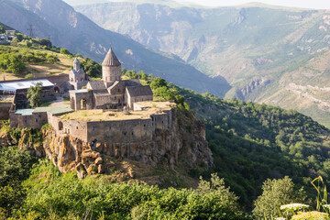
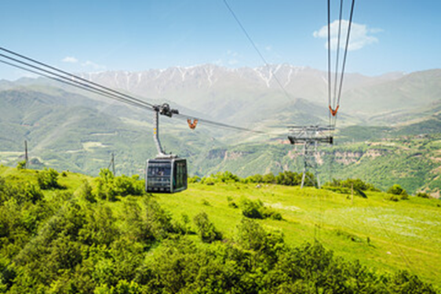
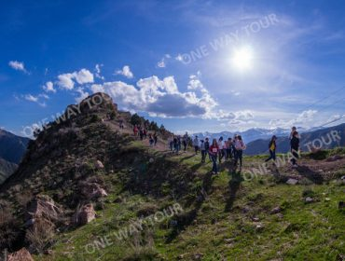
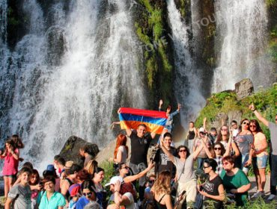
THE PYT PAGE ALSO CONTAINS COGNITIVE INFORMATION ABOUT THE TERRITORY AND PEOPLE, EFFECTIVE STEPS INCREASING THE ATTRACTIVENESS OF THE TERRITORY FOR LIVING, EFFECTIVE APPLICATION OF FORSES AND MEANS, AND TOURISM DEVELOPMENT
Armenia’s “Wings of Tatev” named World’s Leading Cable Car Ride 2023

Slide 62
A FULL TURNOVER OF THE MESSAGES’ MOVEMENT received from the Citizens (Correspondents) on the protection of their territory:
Corres- pondent
PYT page operator
Regional Emergency Service
MEDIA
Reply to the correspondent
Following actions
Competent management authorities
CYCLE INCLUDES:
Sending a message by a correspondent.
Acceptance of the message by the PYT Web page (site) operator and its verification by the regional emergency service.
Transfer of the message to the competent management authorities.
Sending a message to the media.
Taking follow-up action.
Sending a reply to a correspondent.
:

